Slide 1
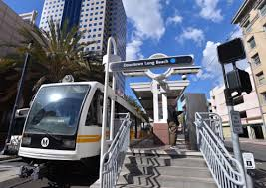
Metro Blue Line Signal Prioritization Project
February 27, 2020
A presentation by:
Carl Hickman, PE, TE
City Traffic Engineer
City of Long Beach Department of Public Works

Slide 2
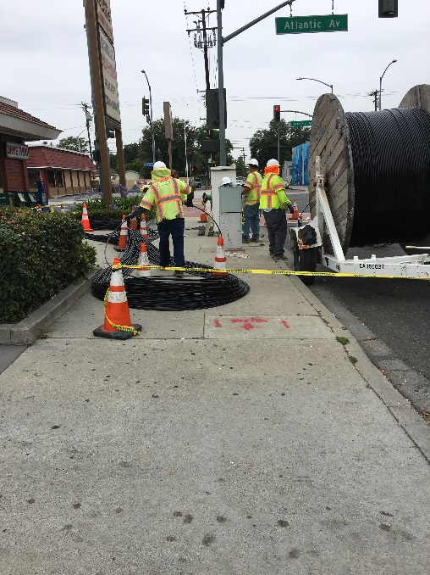
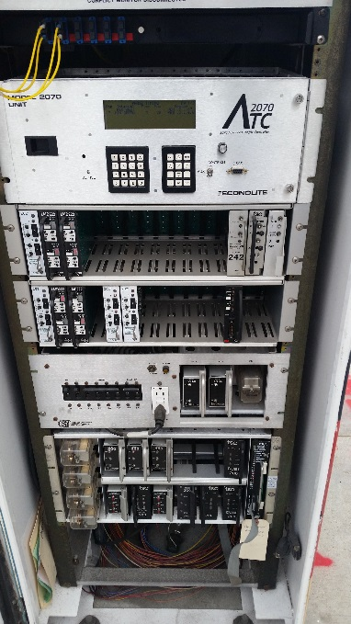
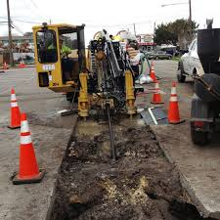
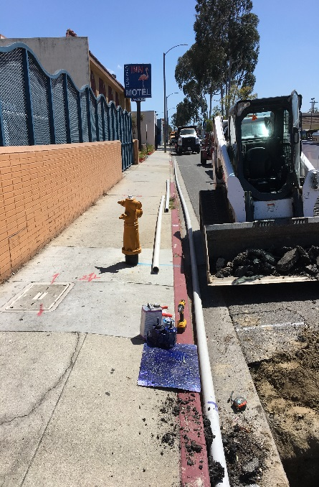
Project
Installation of more than 10 miles of new 96 strand fiber optic cable in existing conduit.
New traffic signal controllers, fiber equipment and software at 85 intersections. CCTV systems at 25 locations.
New signal timing plans for all signals.

Slide 3
Project Map
$2.5M project Funded by 2013 Metro Call for Projects and City of Long Beach matching funds. 33 - Long Beach Blvd. and 52 - Atlantic Ave.
Construction Activities completed in Mid-2019. 1.5 year project

Slide 4
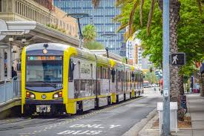
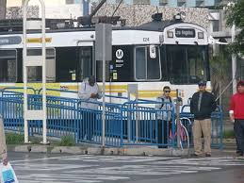
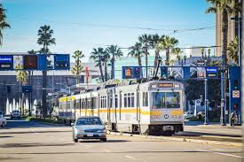
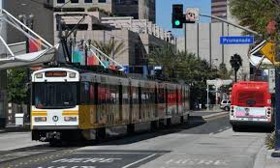
Goals:
A traffic signal system that improves the interaction between all modes of transportation.
Upgrade communications between nearby signal controllers so that rail movement can be anticipated prior to actual arrival.
Reduce the number of rail stops at signalized intersections along the Blue Line corridor.
Reduce overall Blue Line travel times, while creating an improved level of safety for all.

Slide 5
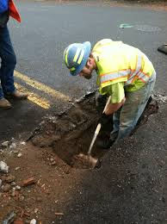
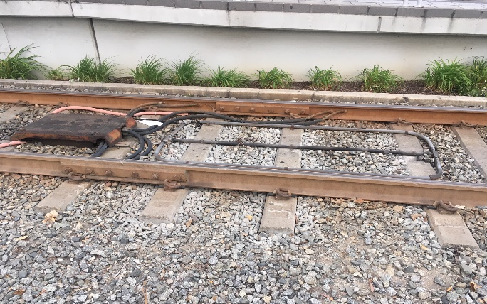
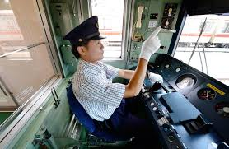
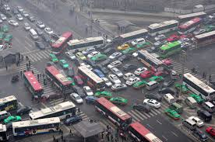
Lessons learned:
1. Maximize the projects ability to fund potholing either pre-design or pre-construction.
2. Be sure that all contractors understand their responsibilities.
3. Establish/coordinate all fiber related splice assignments and IP addressing early on.
4. Be sure that all communications are operational prior to implementing signal timing.
5. Check all rail and vehicular detection prior to conducting travel run studies.
6. Insist on vendor presence to trouble shoot and the latest software.
7. Prepare to fine tune and coordinate with internal staff and rail operators.
8. Understand train travel speeds, station dwell time and conductor behavior.
9. Perform detailed travel studies to verify and quantify benefits of the project.
10. Anticipate conflicting priorities with signal timing and prepare how you are going to address each.

Slide 6
Optimize traffic signal timing and rail operations with:
1. Proper detector loop layout and operations.
2. Increased cycle lengths.
3. Full pre-emption.
4. Phase Omits.
5. Negligible delays or impacts to minor streets.
Results = 5 mile rail corridor with 33 signalized intersections experienced an overall travel time reduction of 7 to 9 min in both North/Southbound directions.

Slide 7
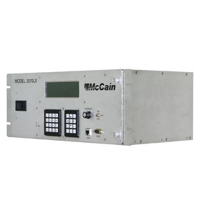
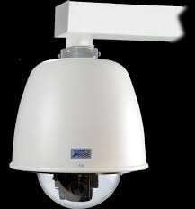
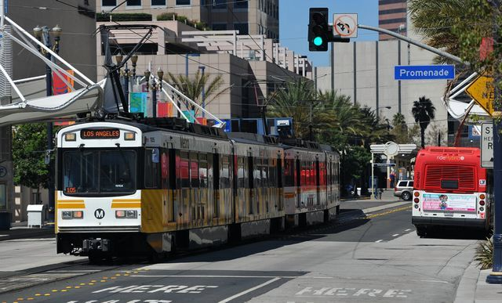
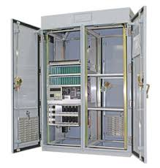
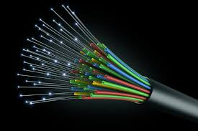
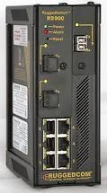
Questions……
Thank you!

